Slide 1
Reward and cooperation in the spatial public goods game: A Netlogo Simulation
A simulation of the spatial public goods game as in Szolnoki and Perc (2010)

Slide 2
Outline
What is Public Goods Game?
Some theory and the Game version used in the paper
The simulation in netlogo
Experiments done and conclusions

Slide 3
What is “the Public Goods Game”?
The public goods game is a standard experimental paradigm in economics and social science that investigates how individuals make decisions about contributing to a common resource or public good

Slide 4
Public Goods Game
Participants make individual, confidential decisions about whether to contribute their money (Coop) to a shared pool, or not (Defect).
The total amount contributed by all players forms the public pot, representing the collective investment in a common good or resource, is then multiplied by a factor ‘r’, greater than 1.
The multiplied sum is then evenly distributed among all participants, irrespective of their individual contributions.

Slide 5

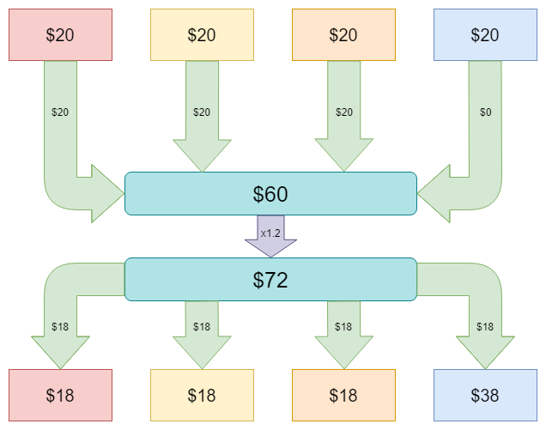
Public Goods Game
An example with four people and ‘r’ factor of 1.2

Slide 6
Payoff matrix
J
 | D | C
D | 0 0 | 3 -1
C | -1 3 | 2 2
I

Slide 7
Encouraging Cooperation
In order to increase cooperations this study proposes to add a reward only for contributors, to which players can choose to participate (RC) or not (C).
While this incentive successfully increases the number of cooperators, it also causes a secondary issue: second-order free riders.

Slide 8
Parameters
r: the factor by which the public goods are multiplied by
Beta: the extra reward for contributors
Gamma: the cost of the reward for contributors.
K: the neighbors of the agent
N_{C}, N_{D}, N_{RC} : number of agents for each strategy among the k neighbors

Slide 9
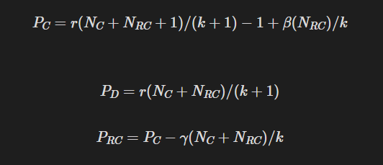
The new payoffs

Slide 10

SETUP
N agents in a 141 x 141 square lattice are given a random strategy between Defect (in red), Cooperator ( in blue) and Rewarding Cooperator (in green)

Slide 11
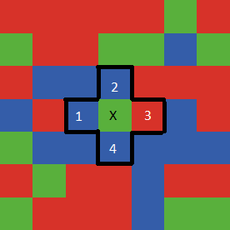
Step 1
An agent, denoted as X is randomly selected
X plays the Public Goods Game (PGG) with their 4-connectivity neighbors
Their neighbors do the same, so 5 games are played
X receives a payoff P_{x} for each game depending on their strategy, as shown in the previous slide.

Slide 12
Example

Slide 13
The simulation
A random neighbor (1, 2, 3 , 4) in the previous example is selected as Y
Y undertakes the same process as X in the step before
Y gets its payoff P_{Y} from the five games played.

Slide 14
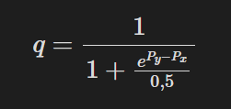
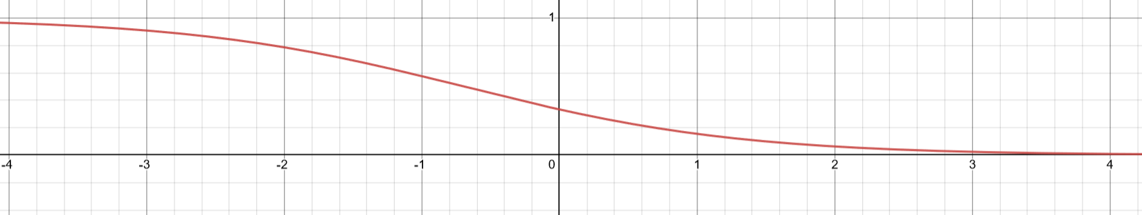
Final Step of the loop
After receiving the payoffs, agent Y can copy agent X strategy with a q provability which increases the former performs worse than the latter.
The function that matches (P_{X} - P_{Y}) with the probability q is shown in the image below.

Slide 15
Experiments
My experiments involved the manipulation of three parameters within the payoff formula: r, Beta, and Gamma
The value of r was held constant at three different levels (2.0, 3.5, and 4.4). On the other hand, Beta and Gamma were varied within specific intervals to observe their impact on the simulation outcomes.
I run the simulation for 1000 iterations for each configuration in on a 141x141 grid, then I compared the results of my simulation with the ones in the paper.

Slide 16
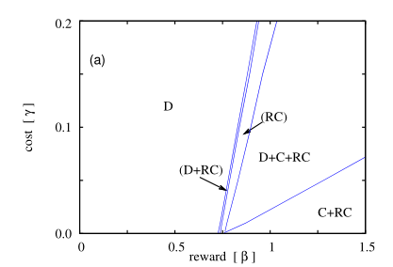
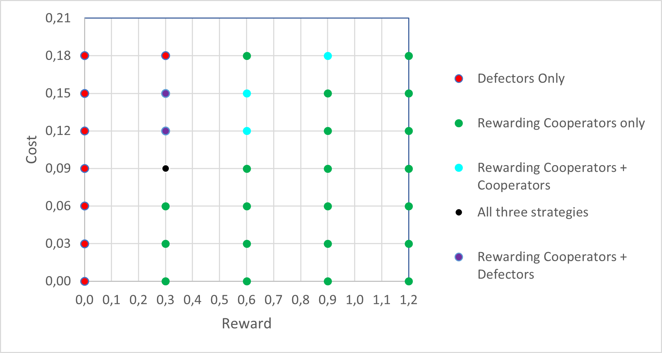
Experiments for r=2

Slide 17
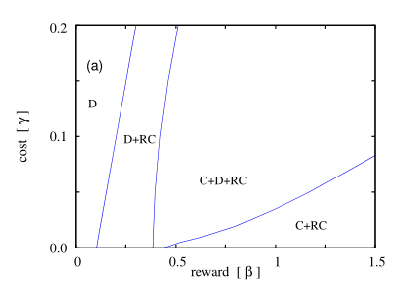
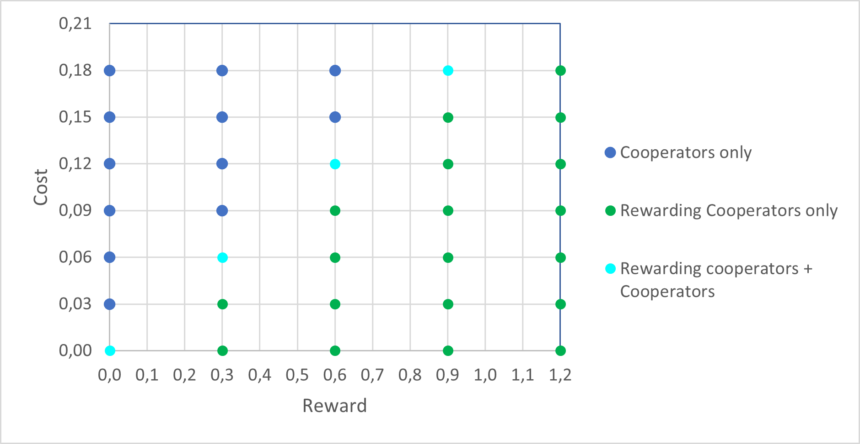
Experiments for r=3.5

Slide 18
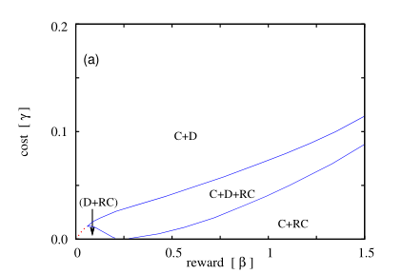
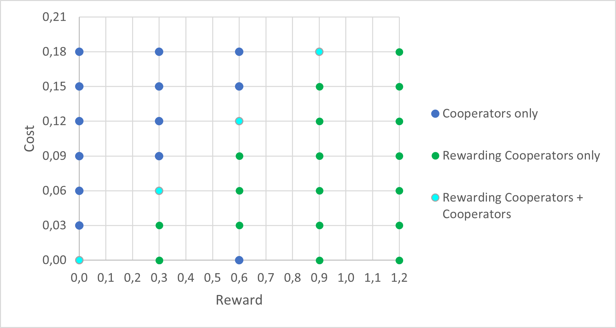
Experiments for R=4.4

Slide 19
Conclusions
Based on my experiments, the addition of a reward for cooperators is very effective, because in few iterations the number of defectors plummets.
The most important parameter is still the ‘Sinergy factor’ ‘r’
A higher value of 'r' reduces the appeal for players to defect and encourages cooperation

Slide 20
Thank You!
All the code, this presentation and the Excel with the experiments are available on my GitHub at https://github.com/andreavale98/Netlogo-Public-Goods

